Slide 1


TY Coding
Lesson 04 - Testing Code

Slide 2
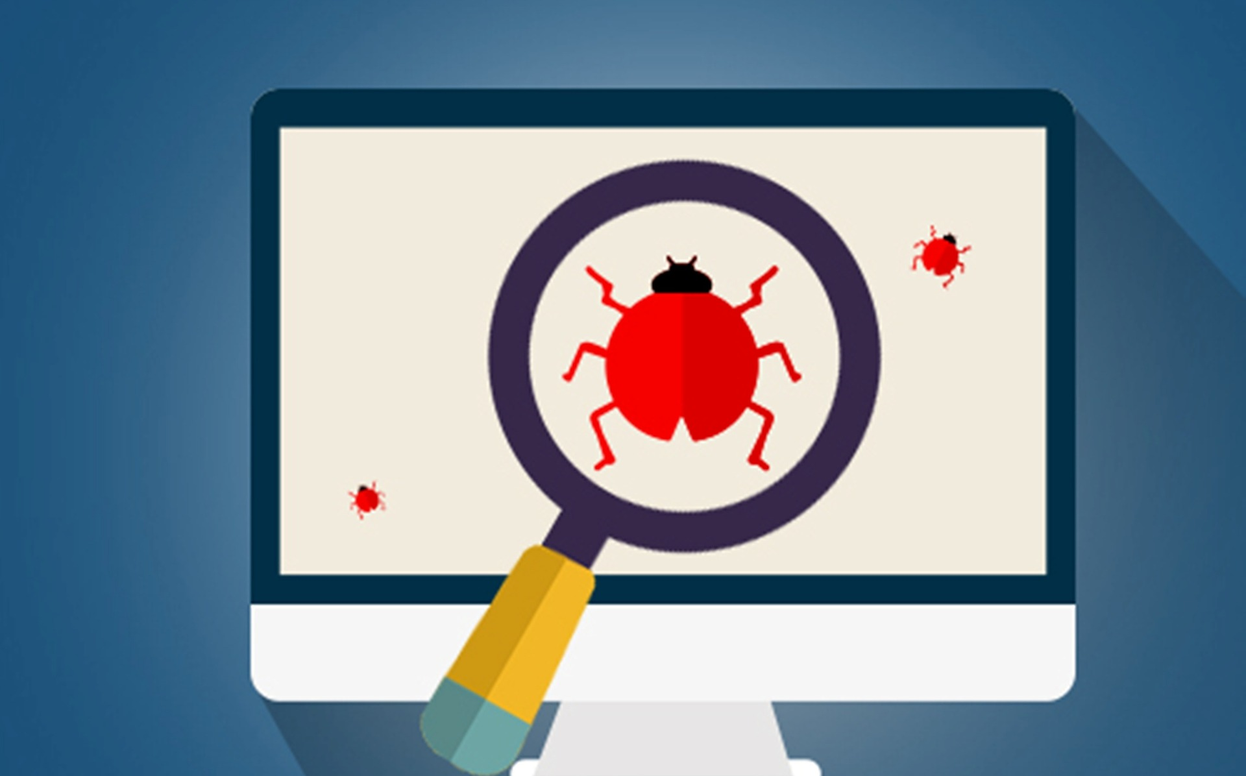
PART 1 WHY WE NEED TESTING

Slide 3


WHY WE NEED TESTING
For the most part, humans write software and humans make mistakes.
Early and continuous testing identifies faults/defects in a software system early on, finding and fixing issues early on improves the quality of the software and saves time.
A flawed software product can impact a product or company's reputation.
We need to make sure our software is safe to use and protects its users from threats.
Some people rely on the software in vehicles, medical devices and other machines to keep them safe, as developers we need to take this responsibility very seriously.

Slide 4

WHY WE NEED TESTING
Mars climate orbiter
On its mission to mars in 1998, the climate orbiter was lost in space.
It took a long time for engineers to understand what had happened.
A sub-contractor on the engineering team had failed to make a simple conversion from imperial units to metric units!
This embarrassing mistake caused the $125,000,000 orbiter to smash into the mars atmosphere. This crippled the communications and sent the craft hurtling around the sun.

Slide 5

WHY WE NEED TESTING
Fiat chrysler
In 2016 recalled over 1 million vehicles.
Government investigation revealed a
gear-shift flaw which resulted in:
266 accidents
68 injuries
At least 1 death (actor Anton Yelchin)
A software update was issued after the recall, however the update reportedly failed to work for a further 29,000 vehicles.

Slide 6


WHY WE NEED TESTING
UK national health service
Admitted to mis-prescribing medication to 300,000 heart patients due to a software error.
Systmone, the software used to calculate the risk of a heart attack, has reportedly produced incorrect results since 2009.
This has led to patients:
Suffering needlessly from heart attacks or strokes.
Suffering serious side-effects from taking unnecessary medication.

Slide 7
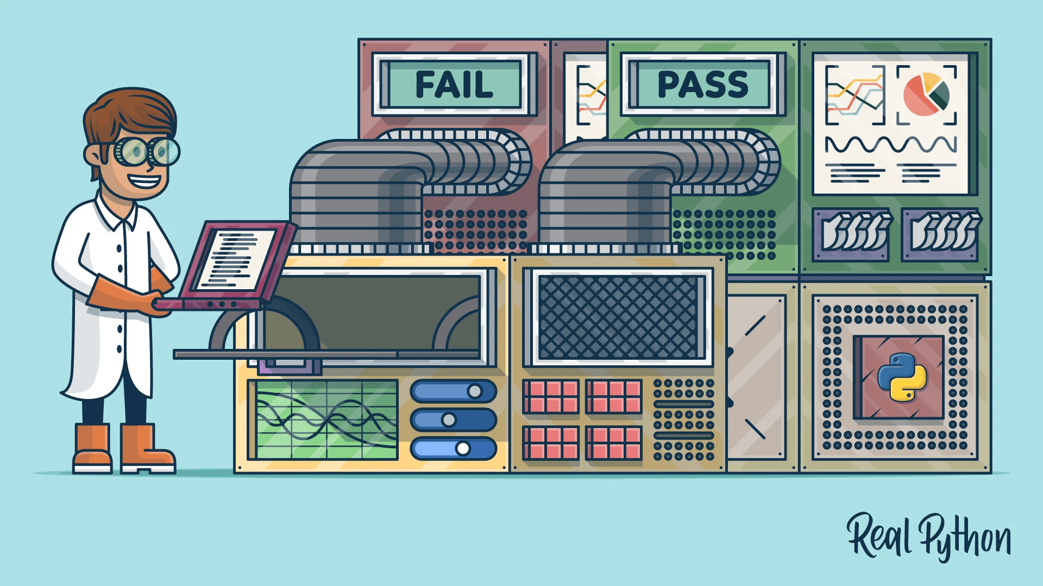
PART 2 TEST CASES

Slide 8
TEST CASES
A test case is a template used to create tests for software
A test case usually contains at least:
Title: the title of the test case- keep it short.
Description: a description of the test - make this more detailed.
Test data: any data that you need to complete the test.
Test steps: clear and concise instructions on how to perform the test.
Expected result: the result you expect to obtain.
Actual result: the actual result that you obtained.

Slide 9

TEST CASES
EXAMPLE OF A TEST CASE – TEST FAILS
TItle: checking a mathematical expression
Description: using a certain set of test data, checking that the mathematical expression:
188 + 68 * 1 + 3 Code logic is correct and returns the correct answer.
Test data – the numbers to be used in this test.
TEST STEPS:
Navigate to trinket.io and create a print() function.
Inside the print function put in the mathematical expression: 188 + 68 * 1 + 3
Click on the run button to run the program.
Record your result.
EXPECTED RESULT: 1024
ACTUAL RESULT: 259
188 | 68 | 1 | 3

Slide 10


TEST CASES
Do you know why the test failed?
There was a logic error in the code.
Even though the test failed, we still consider this a good thing.
The test let us know that we had an error in our code.
Do you know what the problem was?
Our calculation was missing some brackets!
Remember that in Python we follow the PEDMAS/BODMAS order of operations.

Slide 11
SUMMARY
Today you learned about:
Why testing is important
We need to test to make sure our code is safe, secure and works as intended.
What can happen if we do not test thoroughly
Malfunctioning machines.
Injury.
Loss of time and money.
Test cases
A test case is a template for running a test.
A test case describes the test, test steps and what result we think we should get.
A failing test is not a bad thing, failing to test is a bad thing.

